Slide 1


Housing Sales Data Analysis
Data Analysis Methods Project
Hrishikesh Anil Patil(M15583739)

Slide 2

Content
Introduction
Data Cleaning
Data Visualisation
Insights & Analysis
Conclusion

Slide 3

Introduction: Unveiling Insights in Cincinnati's Real Estate Market
In the vibrant city of Cincinnati, a vast repository of housing sales data beckons exploration, featuring intricate details of property transactions, including sale prices, locations, and various attributes like bedrooms, bathrooms, and lot sizes. Our mission is clear: to decipher the underlying trends shaping the housing market through exploratory data analysis (EDA) and provide invaluable insights to prospective buyers and astute investors navigating Cincinnati's dynamic real estate landscape. With a focused scope, methodological rigor, and an anticipatory gaze toward uncovering trends and factors influencing property prices, our journey promises to deliver actionable insights tailored to empower stakeholders across the real estate spectrum. As we embark on this data-driven odyssey, we envision a future where informed decisions drive success and prosperity in Cincinnati's real estate market.

Slide 4

Data Cleaning Steps
Data Loading and Inspection
I loaded the Cincinnati housing dataset to begin our analysis. We examined its structure to understand the variables.
Column Renaming
I improved column names for clarity, making the dataset easier to understand.
Handling Missing Values
I addressed missing values by either imputing them or removing incomplete entries.
Dealing with Outliers
I identified and managed outliers in the dataset to prevent distortion of our analysis.
Data Transformation
I standardized data types and formats to ensure consistency across the dataset.
Ensuring Data Quality
I conducted validation checks to maintain the accuracy and reliability of the dataset.

Slide 5
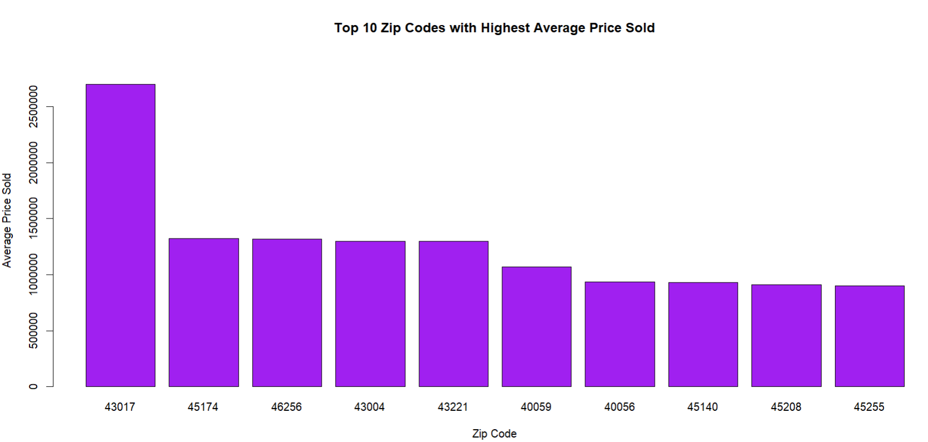
Areas with high property price
The zip codes with the highest average selling price are 43017, 45174, 46256, followed by 43004 and 43221. These areas likely represent the most expensive or desirable real estate markets in our dataset.
There is a significant disparity in average selling prices between the top and bottom zip codes. The average price in 43017 is over $5 million, while the price in 45255 is closer to $500,000. This substantial difference suggests a diverse range of housing types and affordability levels within the data.

Slide 6
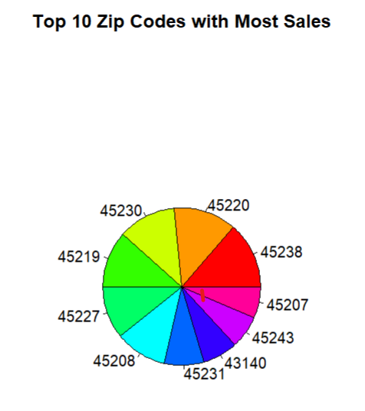
Area with most sales
The zip codes 45230, 45238, and 45220 represent the areas with the most sales within your data set. These zip codes likely have a higher concentration of houses available for sale or a larger population compared to other areas.
The pie chart suggests a somewhat balanced distribution of sales across the top 10 zip codes. The dominant zip codes (45230, 45238, and 45220) each have a share of around 10% to 12%, indicating that there is no single area with an overwhelmingly high number of sales compared to the others.

Slide 7
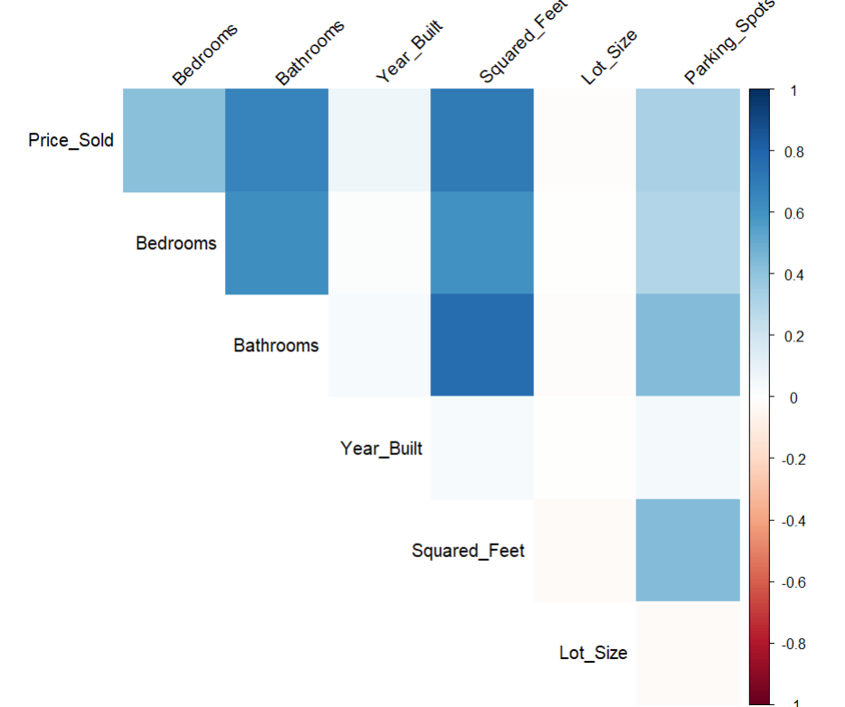
Factors Affecting Selling Price
The Heat map shows the positive relationship between price sol and bedroom, bathroom, squared_feet, and parking_spot, this suggest that are the values of this prices increases the selling price of the house increases as well.
The darker the square plot between price and other variables the more stronger the relationship is, Hence the number of bedrooms and bathroom, squared feet has the strongest influence on the selling price of the houses

Slide 8
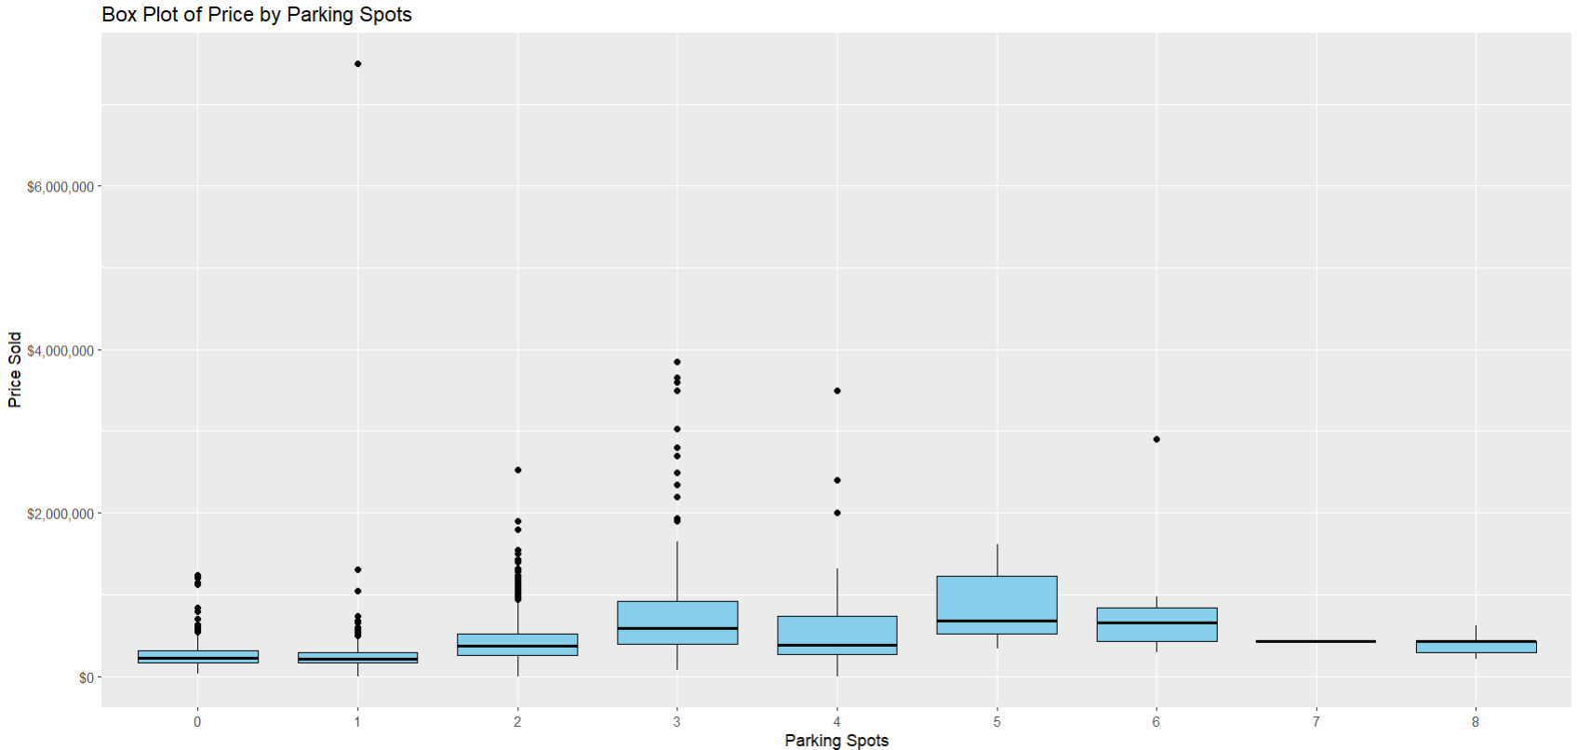
Changes in prices by parking spots
The box plot suggests a possible increasing trend in price with more parking spots.
We also have to many outlier in our dataset hence even when the price increase with parking spots. We can’t be sure with the insights.

Slide 9
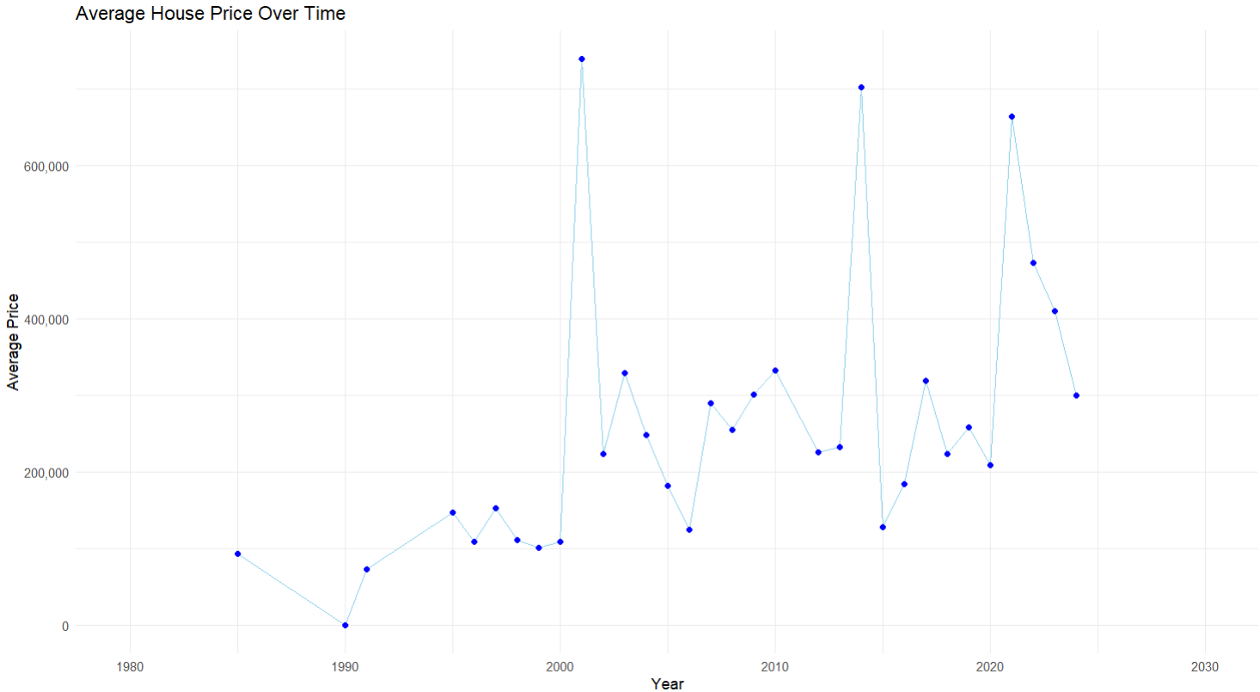
Time Series Analysis for Avg House Selling Price
There appears to be a general upward trend in average house prices over the time frame of 1980 to 2030. This suggests that, on average, houses in your data set have become more expensive over time.
While there is a general upward trend, the line chart also suggests periods of fluctuation in average prices. There might be segments with steeper slopes (indicating faster price increases) and others with flatter slopes or even slight dips.

Slide 10
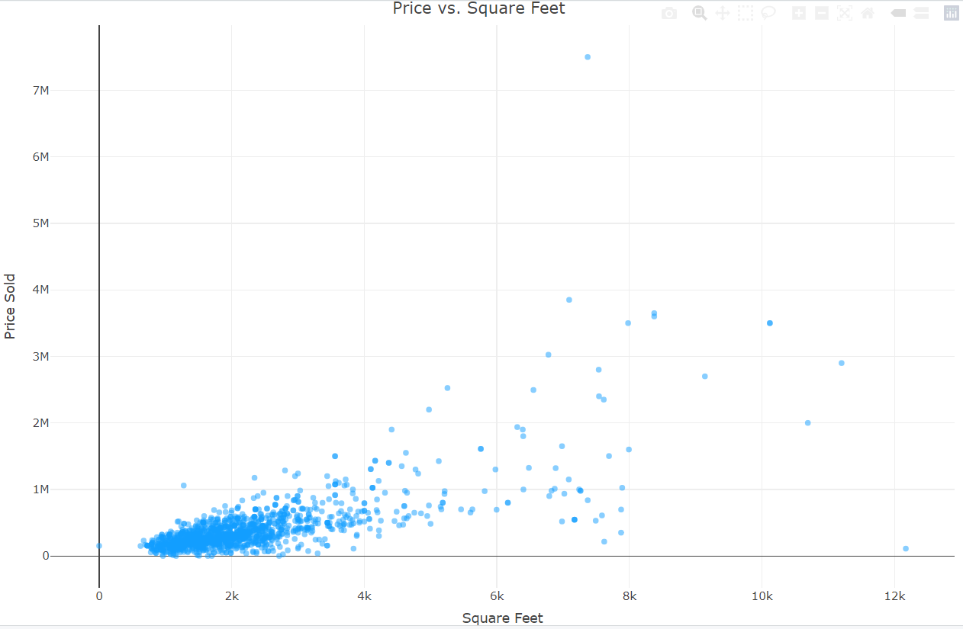
Price VS Square Feet
The scatter plot shows a positive correlation between the price sold and square footage. This suggests that houses with larger square footage tend to sell for higher prices in our data set. This aligns with the expectation that more spacious houses are often considered more valuable.
The data points are spread out across the chart, indicating variation in price even for houses with similar square footage. This suggests that other factors besides square footage also influence the selling price.

Slide 11
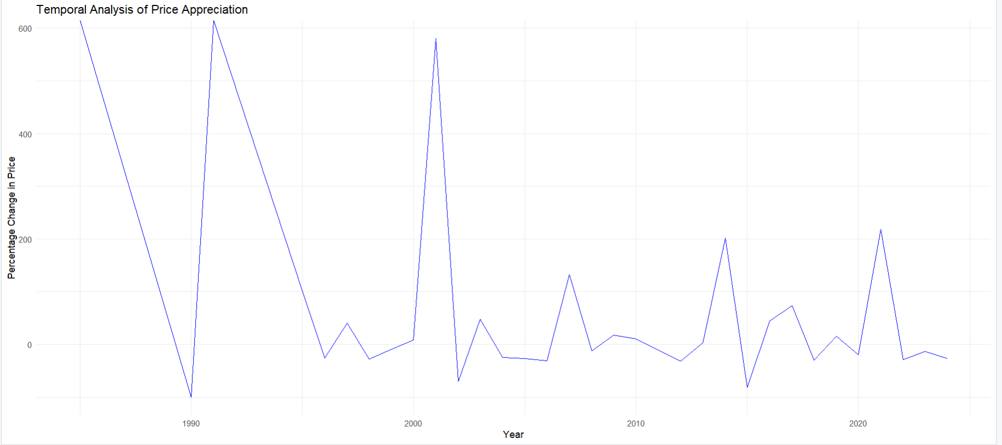
Percentage Changes in Housing Selling Price
The line chart shows significant fluctuations in the year-over-year percentage change in price. There are periods with positive values (price increases), negative values (price decreases), and even some years with close to no change. This suggests that the housing market in our data set has experienced periods of both growth and decline over the years.
There are periods of consecutive years with positive or negative values, suggesting potential cycles of price appreciation and depreciation.

Slide 12
Conclusions
Location Matters: Zip codes like 43017, 45174, and 46256 hold the highest average selling prices, indicating desirable and potentially expensive real estate markets.
Diverse Market: There's a significant disparity in average selling prices across different zip codes, suggesting a range of housing types and affordability levels within your data.
Market Balance: While zip codes like 45230, 45238, and 45220 represent areas with the most sales, the distribution across the top 10 is relatively balanced.
Price Influencers: Factors like the number of bedrooms, bathrooms, square footage, and parking spots generally show a positive correlation with selling price, with bedrooms and square footage potentially exerting the strongest influence.

Slide 13
Conclusions
Parking and Price (Limited Data): While a possible trend of increasing price with more parking spots exists, the data limitations (outliers) make it difficult to draw definitive conclusions.
Long-Term Growth: Overall, average house prices appear to have increased from 1980 to 2030, although periods of fluctuation are also evident.
Beyond Square Footage: While larger square footage generally correlates with higher prices, the data reveals significant variation, suggesting other factors like location and amenities also play a role.
Market Fluctuations: The year-over-year percentage changes in price show significant fluctuations, indicating periods of growth, decline, and stability within the Cincinnati housing market.

